Slide 1
IMHC
Latino Health
Study
REPORT OF PRELIMINARY RESULTS
~Submitted by the Purdue Center for Regional Development
Melinda Grismer, Community Development Specialist
Notes:
NOTE:
To change the image on this slide, select the picture and delete it. Then click the Pictures icon in the placeholder to insert your own image.

Slide 2
PARTICIPANT DEMOGRAPHICS
579 Clinton County Residents of Hispanic Heritage (Aug-Sept 2020)

Slide 3
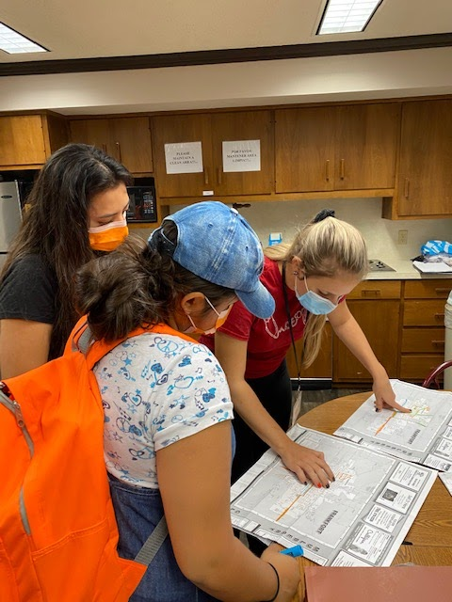
Methodology
15 bilingual surveyors were assigned to five zones throughout the City of Frankfort
In teams of two or three, the surveyors knocked on doors in their assigned zone and asked Latino residents 48 questions
Each survey participant spent approximately 20 minutes answering all the questions, while the surveyors entered the answers and made notes of participants’ feedback
During the course of five (5) weekends, 579 people participated—461 in Spanish and 118 in English.

Slide 4
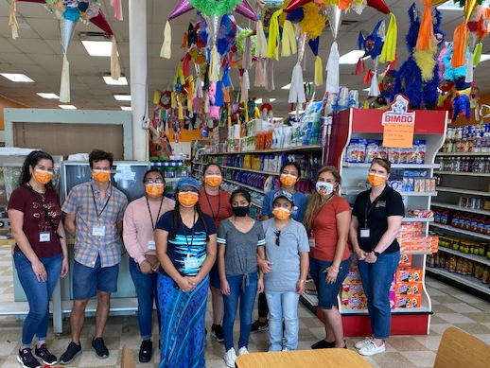
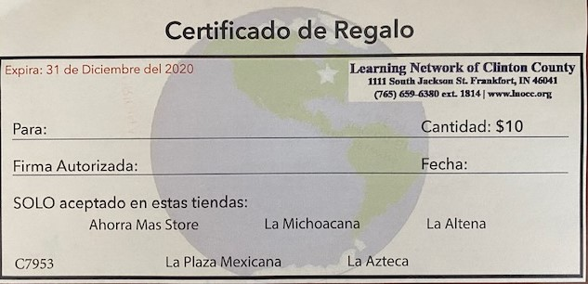
THANK YOU!
Survey respondents were handed a gift certificate in exchange for their voluntary/anonymous participation
Thanks to these Mexican grocery stores for sponsoring gift certificates:
La Altena
La Plaza Mexicana (formerly Tres Hermanos)
Ahorra Mas
La Azteca
La Michoacana (Farmers Fresh Market)

Slide 5
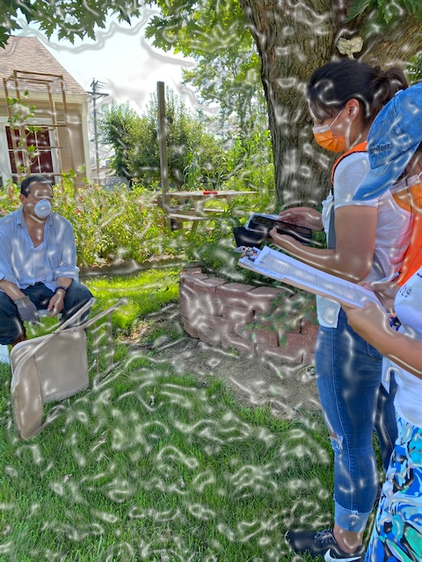
Demographics: Gender, Age, Civil Status & Household Size
55% of respondents were women and 45% were men; none selected other
On average, respondents were 40 years old with four (4) people in their household and two (2) children under the age of 18
51% were married, 18% were living together (union libre), 20% were single, 8% were divorced, and 3% were widowed
On average, respondents have lived in Frankfort for 20 years primarily because of family/friends and the desire for a tranquil community

Slide 6
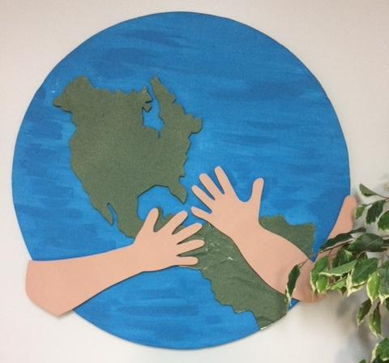
Demographics: National Origin & Where Educated, Education Level
81% of respondents were born in Mexico, 13% were born in the U.S., and 7% were born in other countries (particularly from Guatemala, El Salvador and Honduras)
2% never attended school, 29% of respondents completed primaria, 41% completed secundaria, 22% received a high school diploma/equivalency, 6% completed an undergraduate/graduate degree
69% of respondents went to school in Mexico, 24% went to school in the U.S., and 7% went to school in other countries

Slide 7
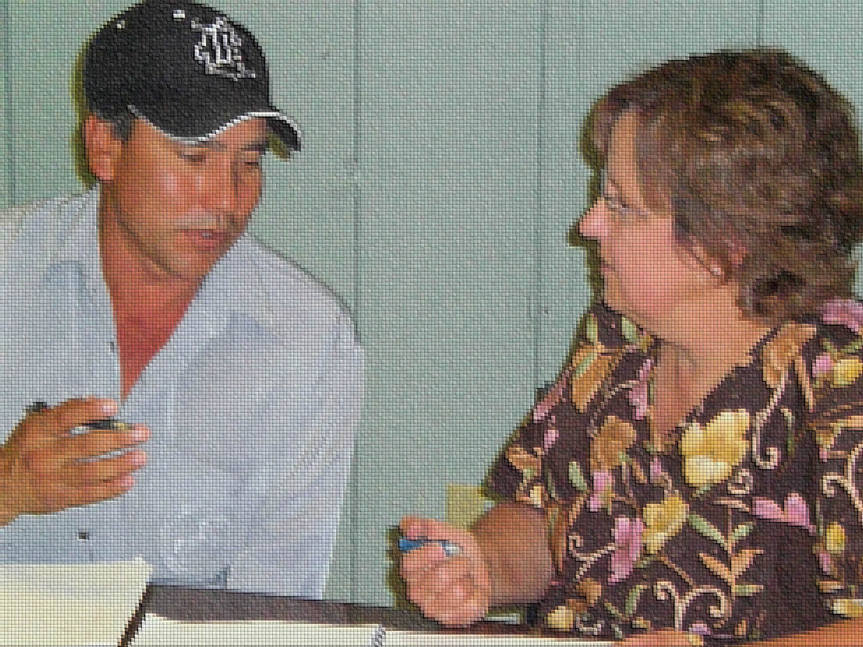
Demographics: Language
74% of respondents can read/write Spanish proficiently, 13% can communicate via reading/writing in Spanish, 11% have survival Spanish reading/writing skills and 2% can’t read/write in Spanish
23% of respondents can read/write English proficiently, 16% can communicate via reading/writing in English, 31% have survival English reading/writing skills and 30% can’t read/write in English
23% of respondents can understand/speak English proficiently, 19% can communicate via listening/speaking in Spanish, 39% have survival English listening/speaking skills and 19% can’t understand/speak in English

Slide 8
Acculturation Issues
41% of respondents had problems with the language barrier when they first arrived, 15% had problems related to work, 12% had legal problems, 6% had medical problems, 5% had other problems, while 21% had no problems
27% of the respondents still have problems with the language barrier, 2% still have problems related to work, 9% still have legal problems, 4% still have medical problems, 14% still have other problems, while 44% have no problems
46% of respondents feel accepted in the U.S., while 50% feel more or less accepted. Only 4% don’t feel accepted.

Slide 9
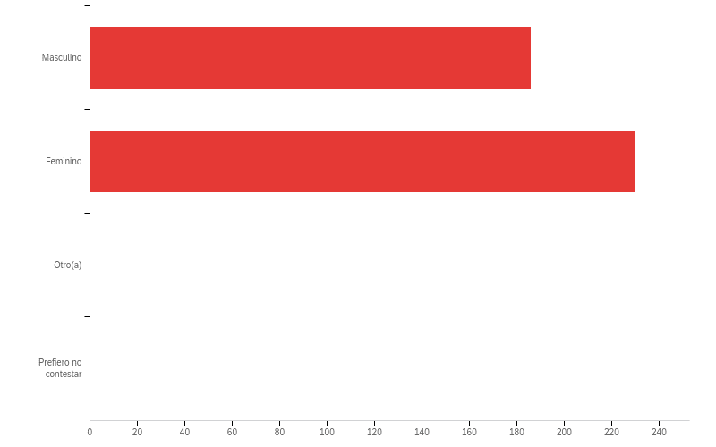
¿Cuál es su género?

Slide 10
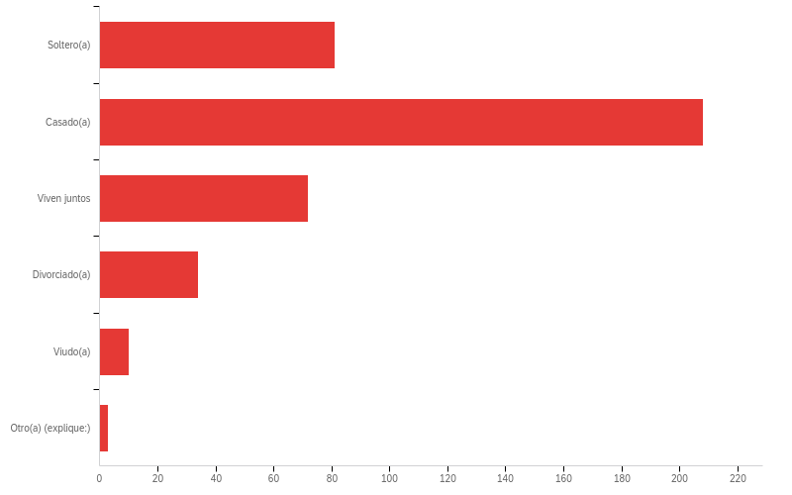
¿Cuál es su estado civil?

Slide 11
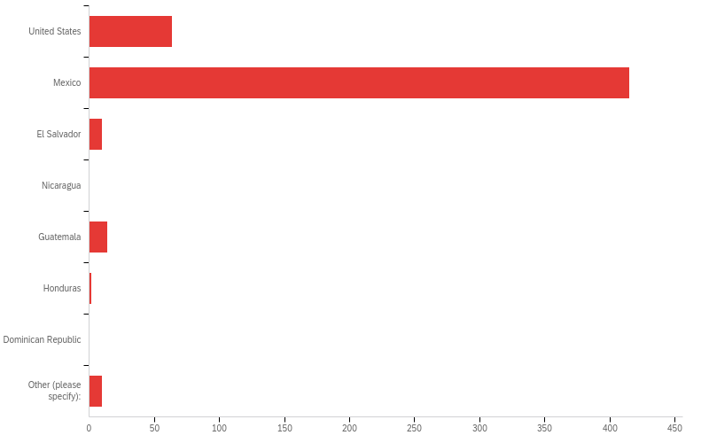
¿Dónde nació Ud.?

Slide 12
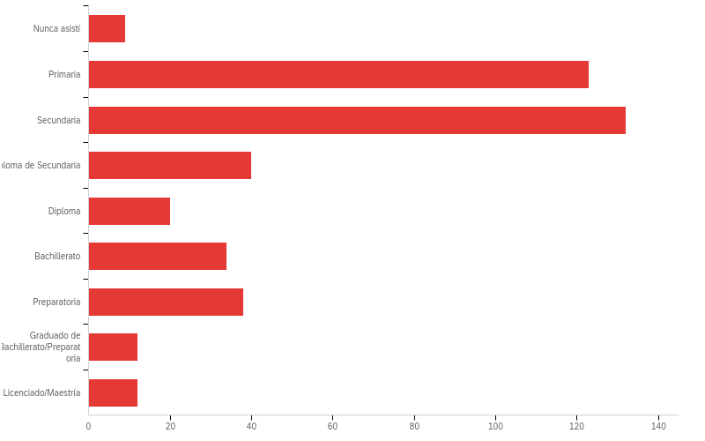
¿Cuál es el grado de educación más alto que Ud. realizó?

Slide 13
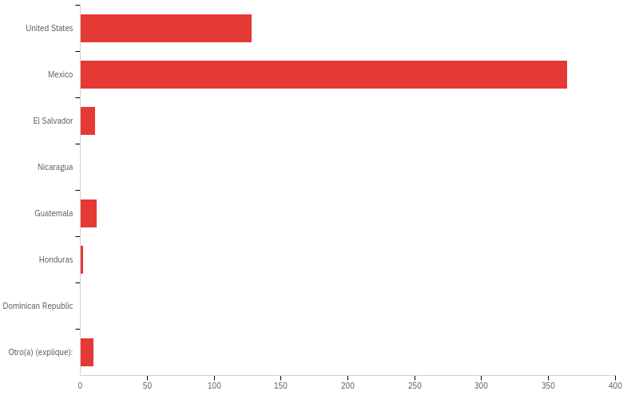
¿En cuál país asistió Ud. a la escuela?

Slide 14
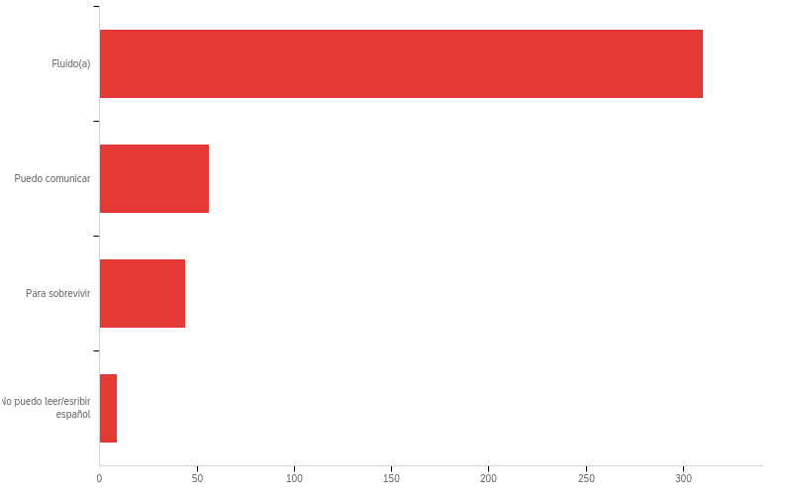
¿Qué tan bien puede Ud. leer/escribir español?

Slide 15
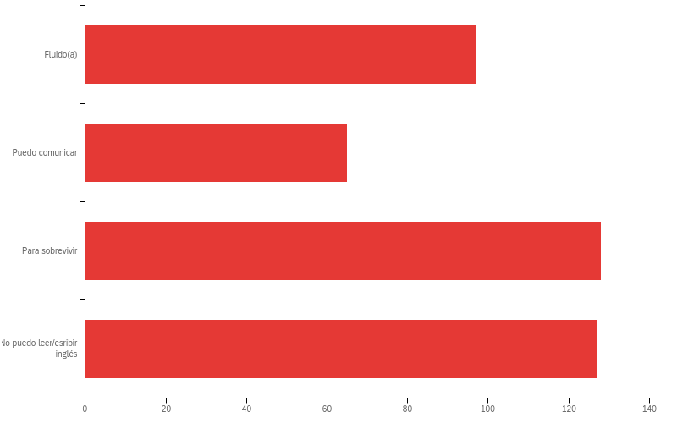
¿Qué tan bien puede Ud. leer/escribir inglés?

Slide 16
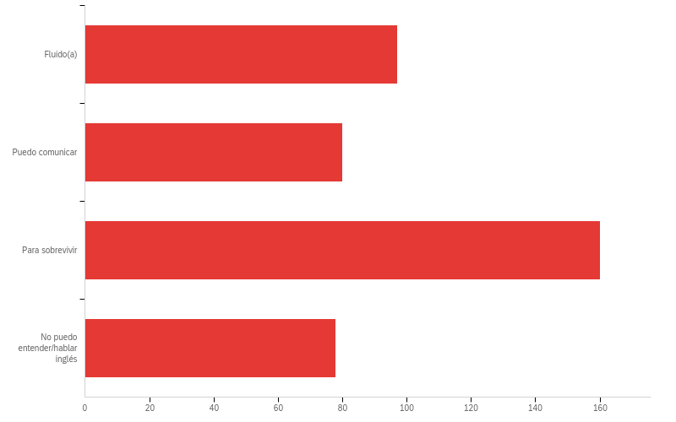
¿Qué tan bien entiende y habla Ud. el inglés?

Slide 17
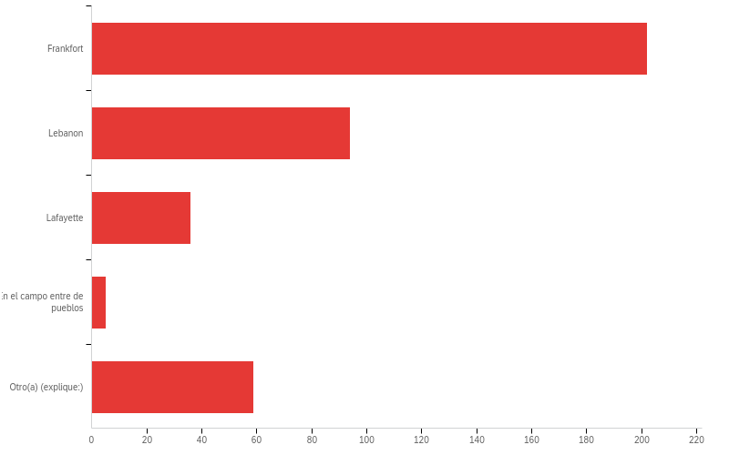
¿Dónde trabaja(o) Ud.?

Slide 18
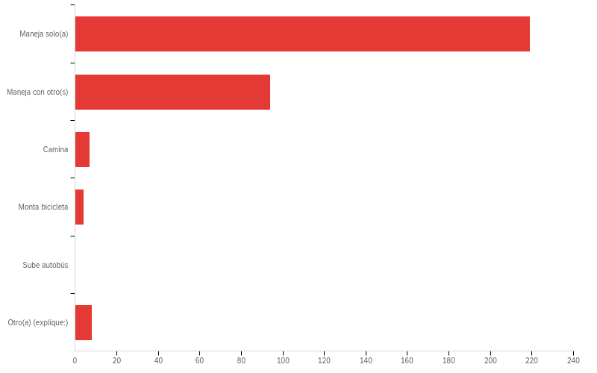
¿Cómo llega(o) Ud. al trabajo?

Slide 19
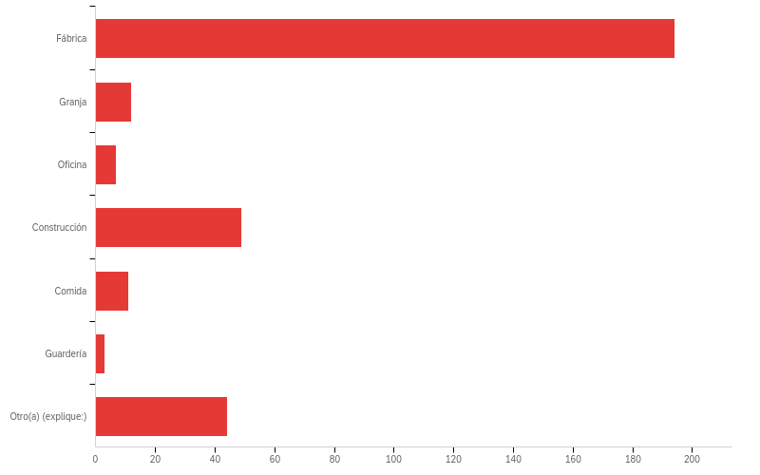
¿Qué tipo de trabajo hace Ud.?

Slide 20
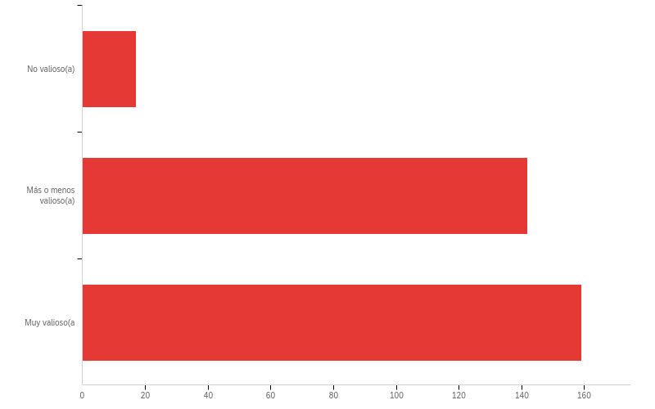
¿Qué tan valioso(a) Ud. se siente en el trabajo?

Slide 21
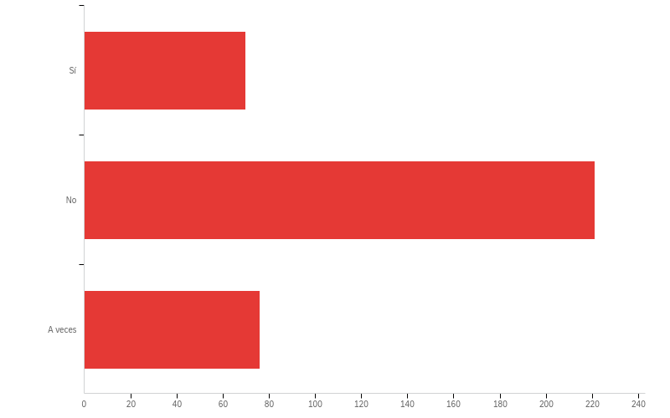
¿Su trabajo es peligroso?

Slide 22
COVID-19 IMPACT
How has the COVID-19 crisis directly the Latino population in Frankfort?

Slide 23
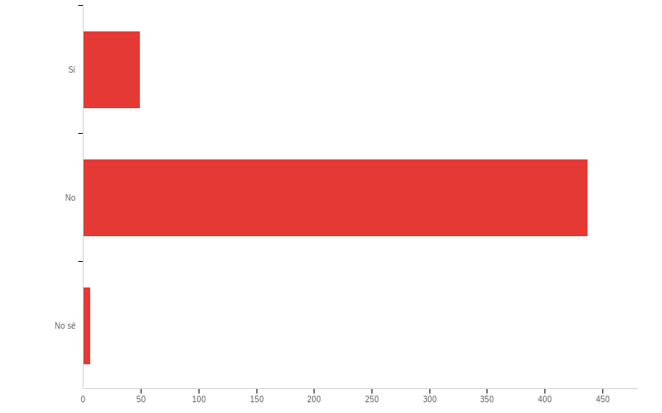
¿Usted o alguien de su hogar ha dado positivo en la prueba de COVID-19?
10%
89%
1%
Notes:
About 10% of respondents have knowingly tested positive for COVID

Slide 24
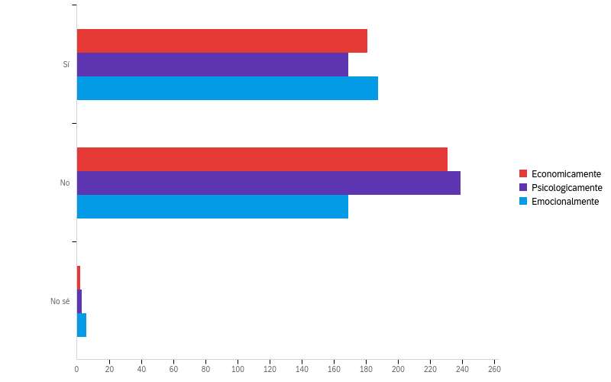
¿De que manera el COVID-19 ha afectado negativamente a usted y su familia?
44%
41%
52%
Notes:
About half of all respondents say they have been emotionally affected by COVID, while 44% have been affected economically and 41% have been affected psychologically

Slide 25
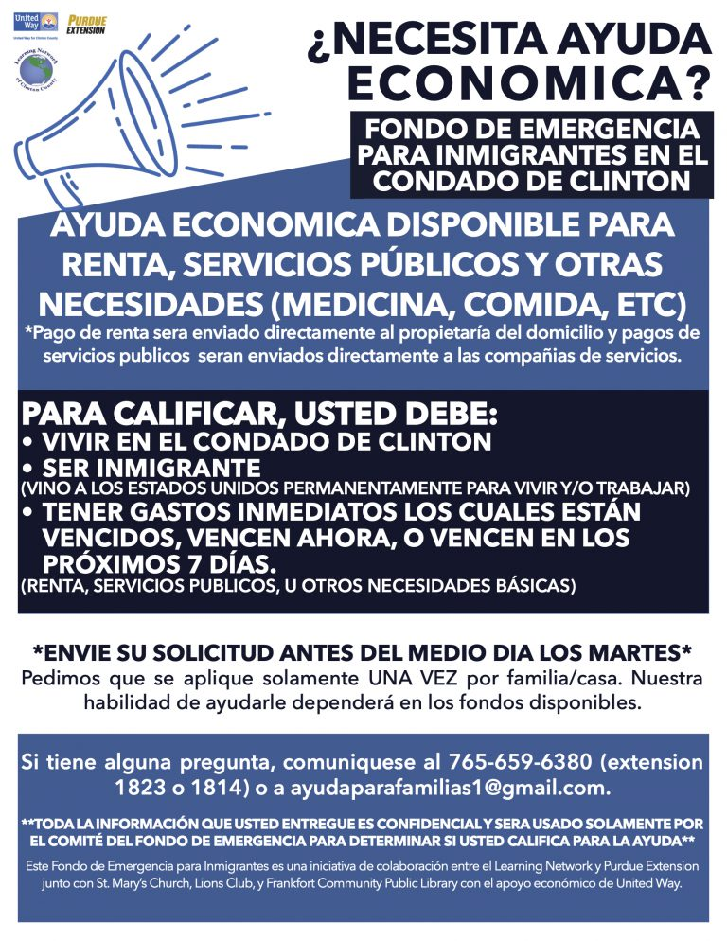
Emergency Fund
Soon after the COVID situation began shutting down local businesses and restaurants, Purdue Extension Educator Esmeralda Cruz Figueroa began collecting data on the impact of this crisis on local Latino families. Since many workers were either considered “essential” and were in need of PPE or were laid off due to the contracting economy, it was estimated nationwide the Latinos were suffering a higher percentage of economic loss than other demographic groups.
Cruz Figueroa wrote a grant to the United Way for $10,000, which was awarded and distributed by the Learning Network of Clinton County during the summer of 2020. In partnership with St. Mary’s Catholic Church, which matched the grant award, about $20,000 in aid was allocated to local Latino families through the Emergency Fund.

Slide 26
HEALTH STATUS

Slide 27
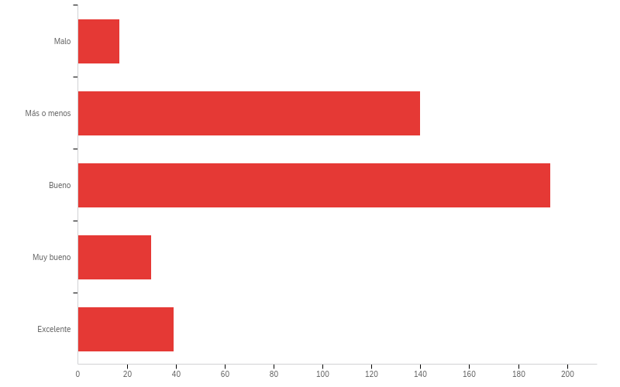
¿Cómo está su salud...?
4%
34%
46%
7%
9%
Notes:
38% of respondents are in so-so or bad health—room for improvement

Slide 28
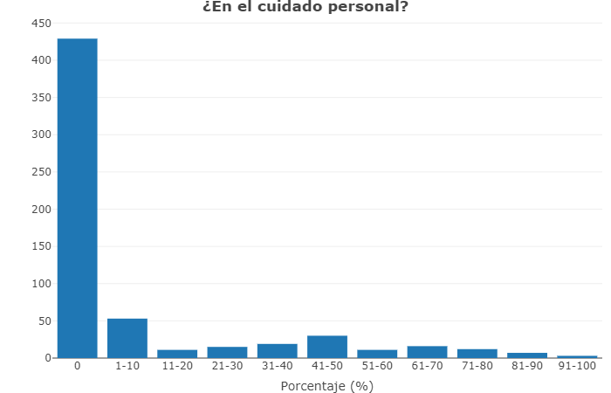
¿Cuál porcentaje del tiempo tiene dolor en que le dificultó realizar actividades diarias?
Notes:
174 people (or 41%) responded that pain causes them difficulty in taking care of themselves.

Slide 29
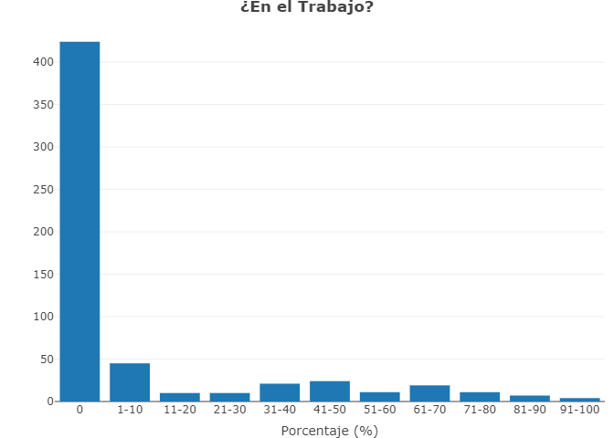
¿Cuál porcentaje del tiempo tiene dolor en que le dificultó realizar actividades diarias?
Notes:
158 people (or 36%) responded that pain causes them difficulty at work.

Slide 30
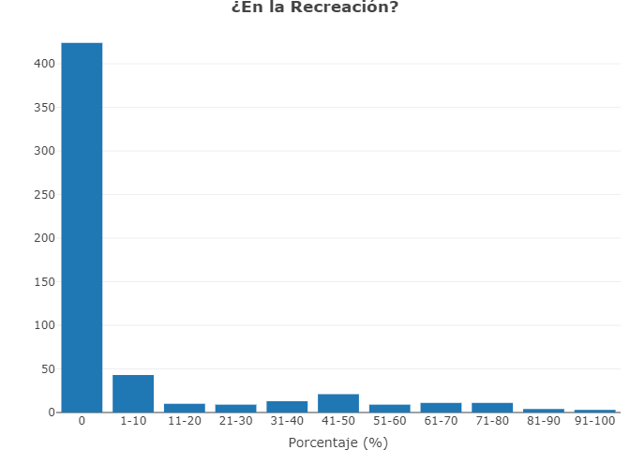
¿Cuál porcentaje del tiempo tiene dolor en que le dificultó realizar actividades diarias?
Notes:
131 people (or 31%) responded that pain makes it difficult for them to participate in recreation.

Slide 31
Clinton County Minority Health Coalition Resources
Indiana Minority Health Coalition addresses health disparities through research, training, education and advocacy in order to offer better access to quality healthcare services for underserved audiences.
Educational sessions, screenings, and other interventions are provided to help improve:
mental health
oral health, while minimizing the risks associated with
obesity and
diabetes.

Slide 32
HEALTH INDICATORS

Slide 33
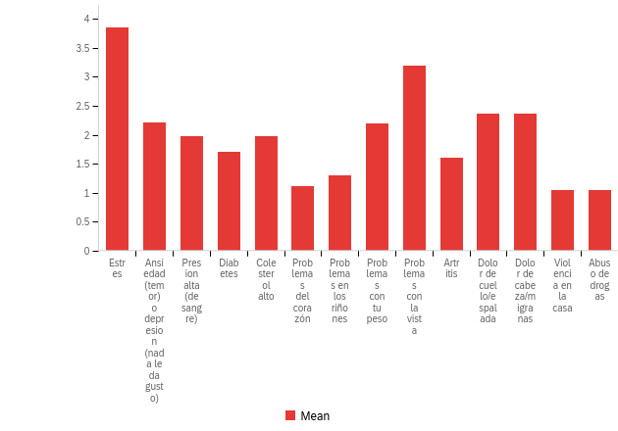
¿ Cuáles de los problemas siguientes de salud le afecta a Ud. o a su familia?
Notes:
Of all the health concerns, these five: 1) stress (related to work), 2) vision problems, 3) headaches/migraines (likely related to work), 4) pain in the neck/back (likely related to work), and 5) anxiety/depression were strongly indicated in the data.

Slide 34
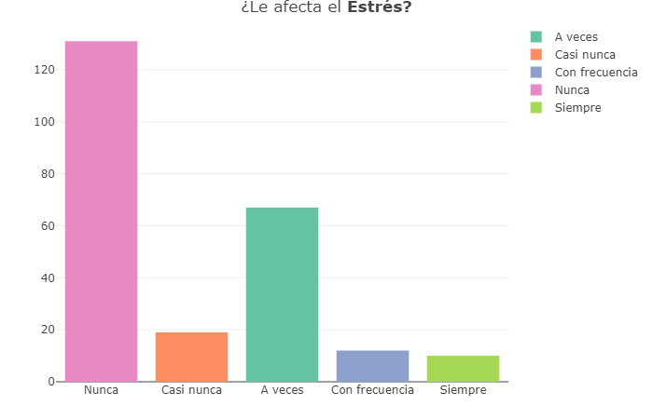
¿Le afecta el Estrés?
Notes:
108 people (or 45%) responded that stress is a health concern for them.

Slide 35
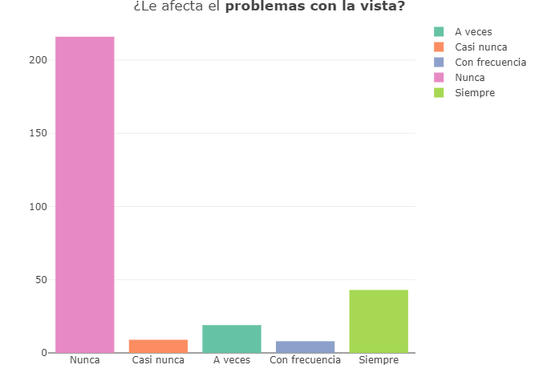
¿Le afecta los problemas con la vista?
Notes:
79 people (or 27%) responded that vision is a health concern for them.

Slide 36
¿Le afecta el dolor de cabeza o migrañas?
Notes:
70 people (or 22%) responded that headaches and migraines are health concerns for them.

Slide 37
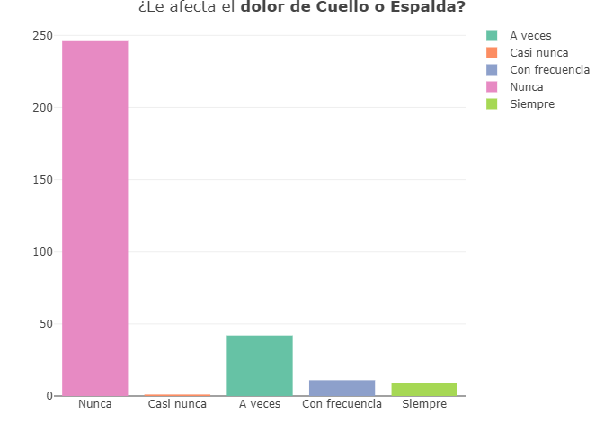
¿Le afecta el dolor de cuello o espalda?
Notes:
63 people (or 20%) responded that pain in the neck or back is a health concern for them.

Slide 38
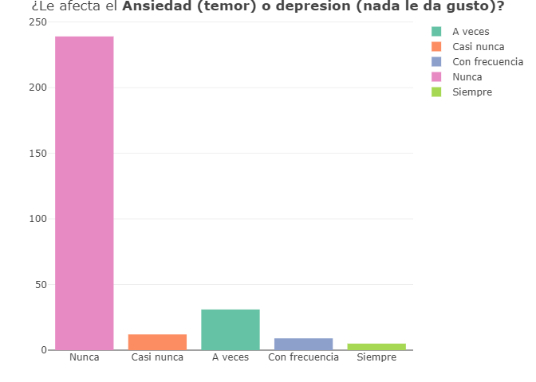
¿Le afecta el ansiedad (temor) o depresión (nada le da gusto)?
Notes:
57 people (or 18%) responded that anxiety and depression are health concerns for them.

Slide 39
Dining with Diabetes
This program is for diabetics or those at-risk for diabetes and their caregivers. It is also helpful to anyone interested in diabetes or friends and family of a person with diabetes. You’ll learn how to lessen the health risks of diabetes. Four to five 2-hour lessons are taught weekly with an optional follow-up lesson.
Topics covered include:
food choice
diet planning
healthy cooking
portion control
medical indicator awareness
healthy activity levels for those with diabetes
Participants watch food preparation presentations, taste tests, and take-home recipes.

Slide 40
HEALTH HABITS

Slide 41
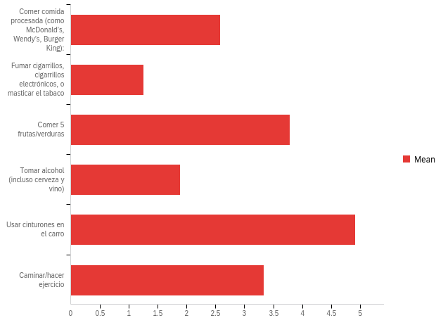
¿ Cuáles de los siguientes habitos de salud forman parte de su vida diaria?
Notes:
BRAVO: Wearing seatbelts, eating fruits/veggies, exercising and not smoking!!
WARNING: Need to reduce amount of daily processed food and alcohol intake.
Ten en cuenta que tus habitos diarios forman tu salud durante el curso de tu vida.

Slide 42
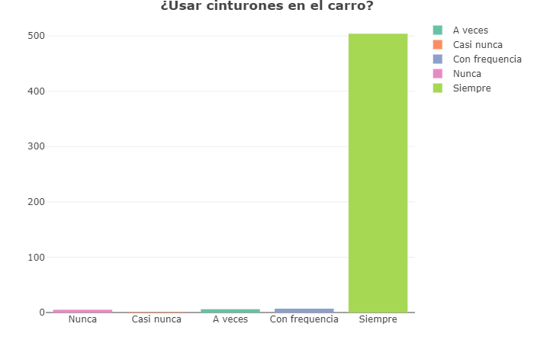
¿Usar cinturones en el carro?
Notes:
518 people (or 99%) responded that they use seatbelts every time they get in the car.

Slide 43
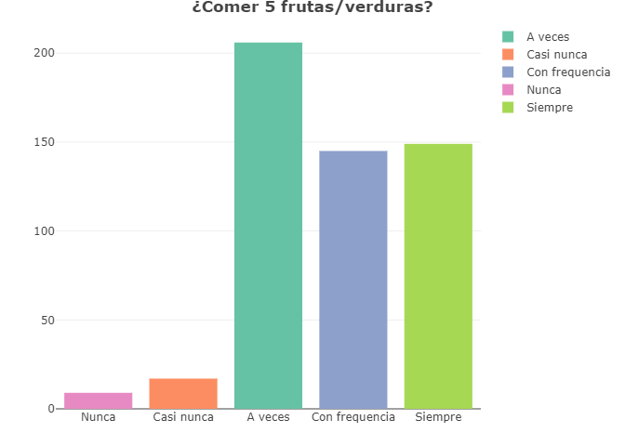
¿Comer 5 frutas/verduras?
Notes:
517 people (or 98%) responded they eat five (5) fruits and veggies a day. That’s great—but be sure to eat more low-sugar fruits and low-carb vegetables.

Slide 44
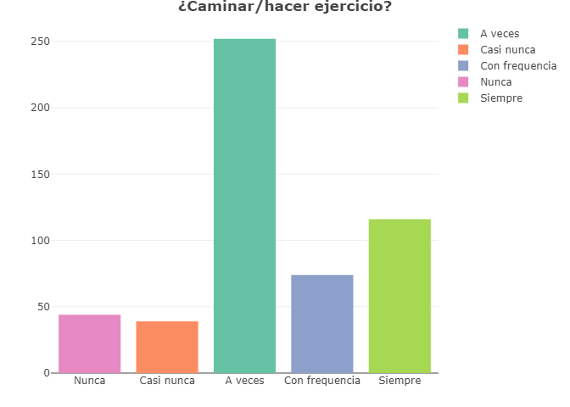
¿Caminar/hacer ejercicio?
Notes:
481 people (or 92%) responded that they walk or exercise every day. Keep up the good work! Try to get at least 5,000 steps in per day.

Slide 45
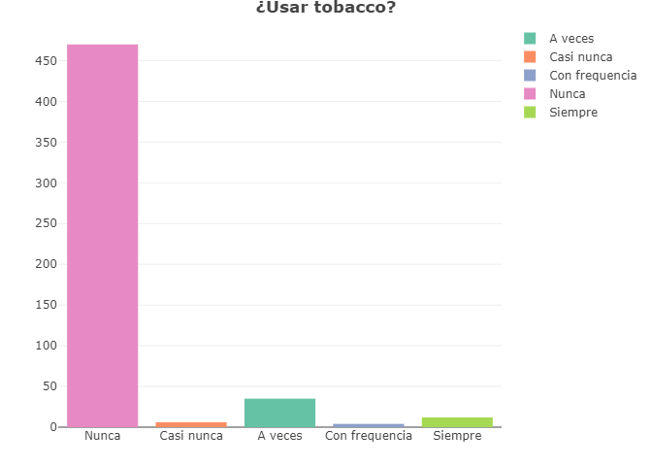
¿Usar tabaco?
Notes:
57 people (or 11%) use some form of tobacco. While that is better than state (21%) and national average (17%), it’s still too much! Try to quit smoking for your health!

Slide 46
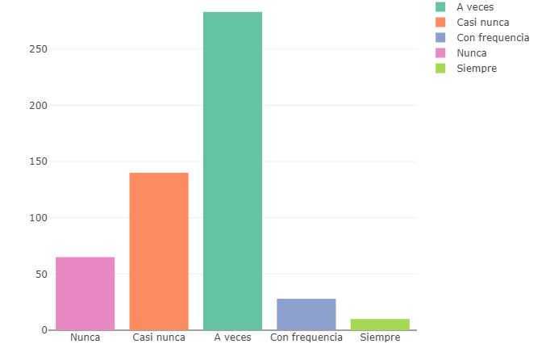
¿Comer comida procesada?
Notes:
461 people (or 87%) responded that they eat some form of processed/fast food on a daily basis. Processed food is bad for you because it contains more sugar, sodium and fat (the bad kind) than your body needs. They make the food taste better, but they lead to serious health issues like obesity, heart disease, high blood pressure, and diabetes.

Slide 47
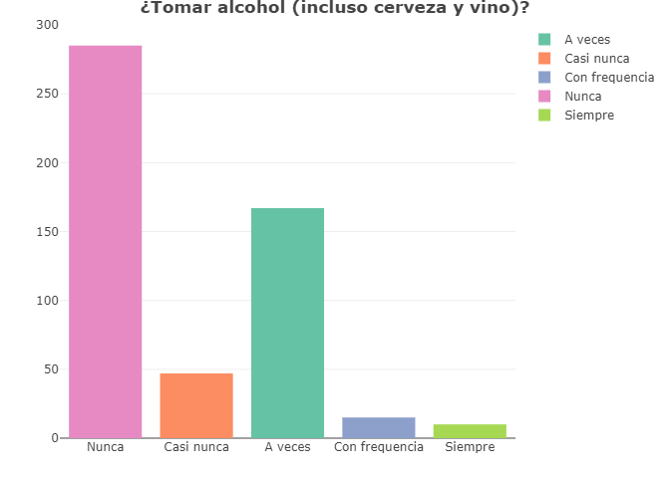
¿Tomar alcohol (incluso cerveza y vino)?
Notes:
239 people (or 46%) responded that they consume alcohol on a daily basis. While no more than one drink per day (for women) and two drinks per day (for men) is within healthy limits, the more you depend on alcohol to get you through the day/relax you, the more you are creating unhealthy habits. Try other ways to relax and unwind at the end of a day, like taking a walk, soaking in the bath tub, reading a book or playing a game with your children.

Slide 48
Serv Safe Training
ServSafe is an educational program developed by the National Restaurant Association to aid restaurants and other retail food handlers comply with the U.S. Food and Drug Administration’s (FDA) code (law) to ensure public safety. In the state of Indiana, the state Department of Health and Food Protection Program serves as the enforcement and oversight agency of the FDA code through the Indiana Retail Food Establishment Sanitation Requirements.
Purdue Extension Educator, Esmeralda Cruz Figueroa, is a certified trainer and schedules quarterly training sessions at the Purdue Extension office in Frankfort in both English and Spanish. See her booth for more information on the schedule of training dates.

Slide 49
Diabetes Prevention Program
Do you have diabetes? Is it something that runs in your family? In this program we will educate you about diabetes - what is it? What changes should you make to live a healthier life? how to prevent diabetes?
The program will be educational in an interactive way. You will learn easy and healthy recipes to include in your meals. Plus exercises to do at home.
Everything will be in Spanish, and we will see each other once a week. Thursdays from 6-7pm at the TPA park for the month of June and afterward at our office.
Are you interested in the program? Please fill out the form below. Questions? Contact Adriana Garcia at 765-659-6380 ext 1814 or agarcia@lnocc.org.

Slide 50
PREVENTIVE HEALTH CARE

Slide 51
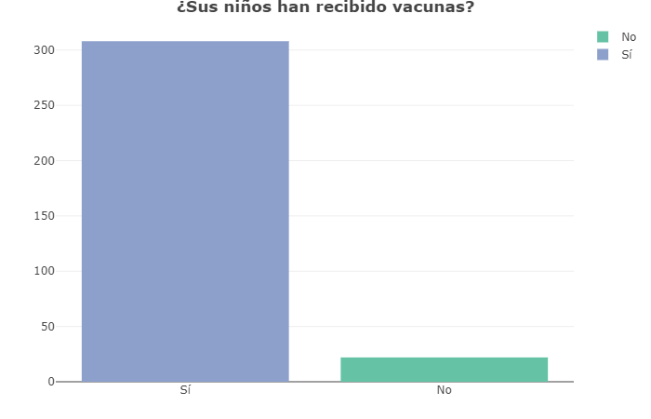
¿Sus niños han recibido vacunas?
Notes:
Only 22 people (or 7%) responded that they have NOT vaccinated their children. Great job!

Slide 52
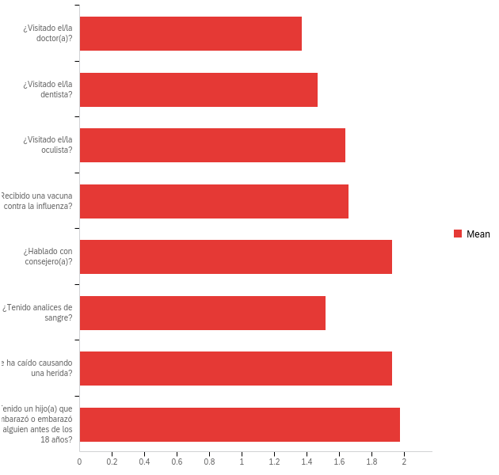
Durante el año pasado (dentro de 12 meses),
Ud. ha:
Notes:
Areas of concern: Very few people talking to counselors relative to the stress/anxiety/depression levels reported. Lots of falls causing injuries. Lots of pregnancies under the age of 18 (while number has been reduced since 2015, it remains an ongoing concern).

Slide 53
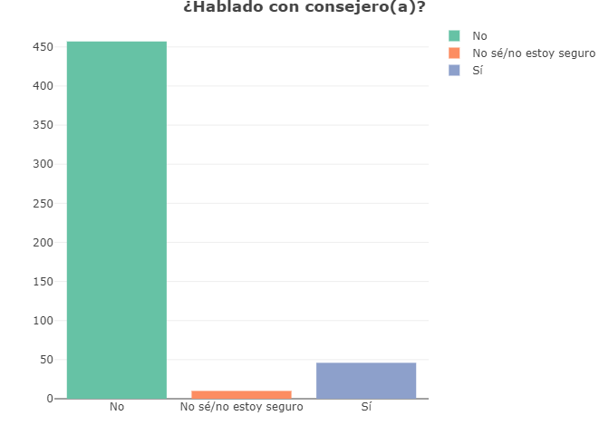
¿Hablado con consejero(a)?
Notes:
447 people (or 91%) responded that they don’t talk to a counselor on an annual basis.

Slide 54
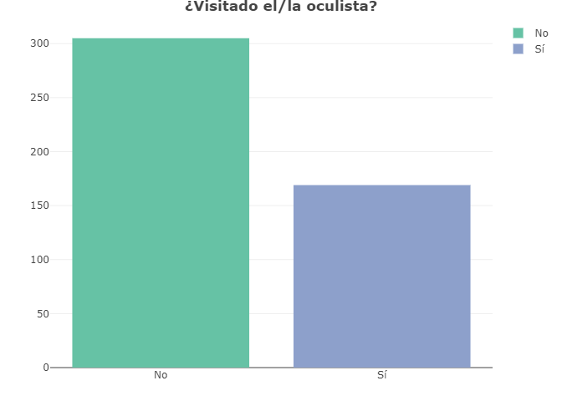
¿Visitado el/la oculista?
Notes:
305 people (or 64%) responded that they don’t visit the eye doctor on an annual basis.

Slide 55
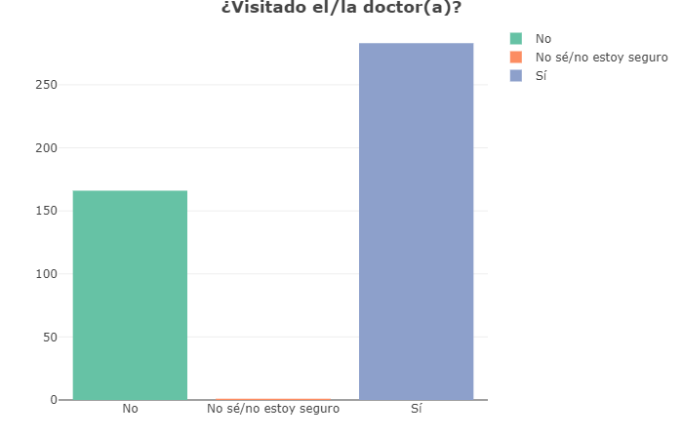
¿Visitado el/la doctor(a)?
Notes:
165 people (or 37%) responded that they don’t visit the doctor on an annual basis.

Slide 56
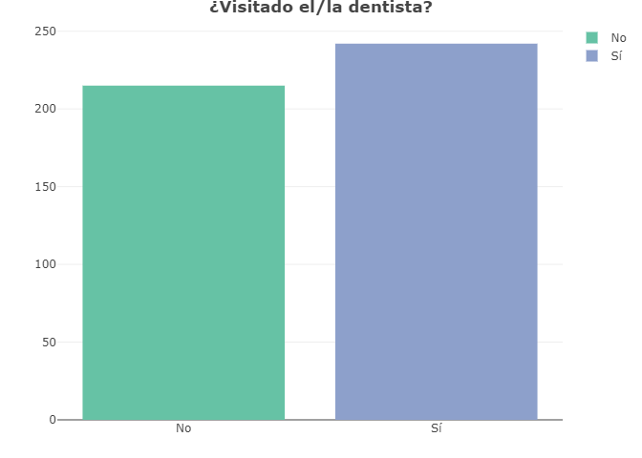
¿Visitado el/la dentista?
Notes:
190 people (or 42%) responded that they don’t visit the dentist on an annual basis.

Slide 57
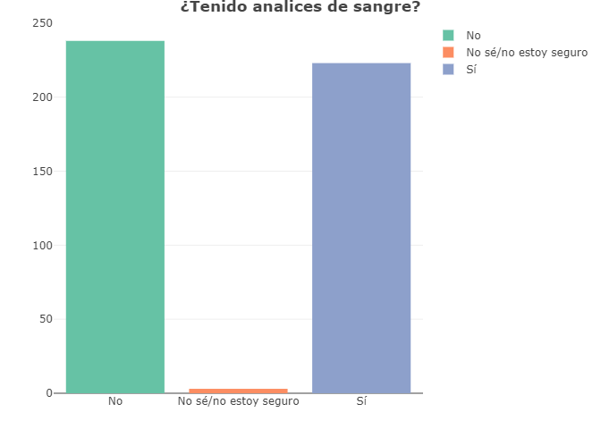
¿Tenido analices de sangre?
Notes:
235 people (or 51%) responded that they don’t have blood tests run on an annual basis.

Slide 58
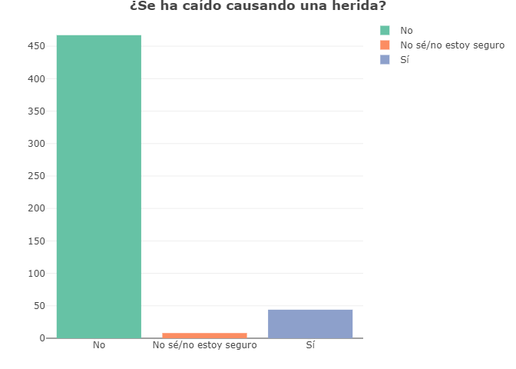
¿Se ha caído causando una herida?
Notes:
459 people (or 91%) responded that they haven’t fallen (causing an injury) in the past year. However, a significant number of people did report falls.

Slide 59
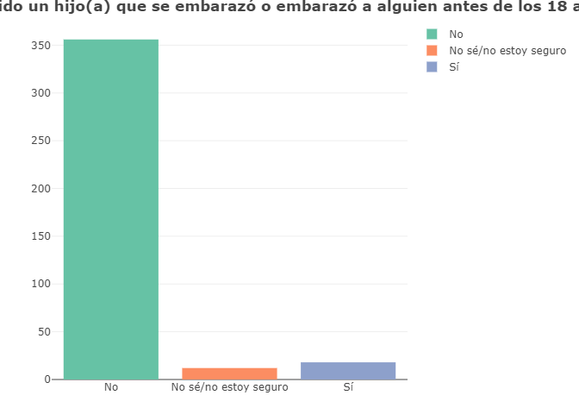
¿Tenido un hijo(a) que se embarazó o embarazó
a alguien antes de los 18 años?
Notes:
334 people (or 95%) responded that no one under the age of 18 in their family has become pregnant (or impregnated someone else). However, the teenage pregnancy rate, while having dropped in the last five years in Clinton County, is still of concern.

Slide 60
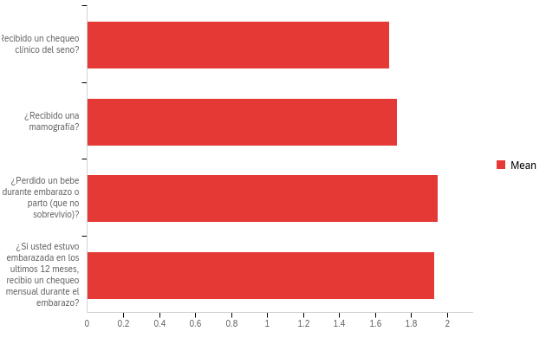
Durante el año pasado (dentro de 12 meses), mujeres han:
66%
66%
8%
89%
Notes:
While women are receiving breast exams and mammograms more than they were in 2010, there are still many that do not have them regularly. Free breast exams are available at Open Door Clinic, and later this year, the Clinton County Minority Health Coalition will be bringing the mammography bus from St. Vincent in Indianapolis. Watch for more announcements. 230 people (or 89% of respondents who were pregnant within the past year) have not received regular monthly checkups. 186 people (or 70% of respondents) have not received a mammogram in the past year. 180 people (or 66% of respondents) have not received a breast exam within the past year. Only 1% of those who were pregnant within the past year (243 people) lost a baby during pregnancy or childbirth.

Slide 61
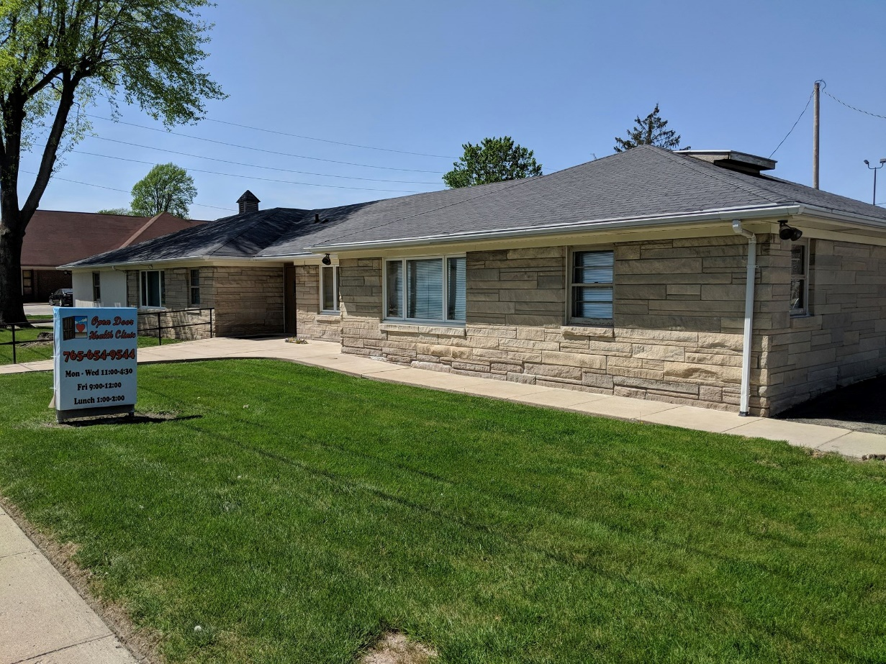
Open Door Clinic
The Open Door Clinic’s mission is to provide free medical care to uninsured and underinsured Clinton County residents.
Free medical services are provided to adults and children with chronic illnesses, minor injuries, physicals examinations, and other health concerns.
Call (765) 654-9544 to schedule an appointment with a medical doctor or nurse practitioner.
The Clinic is open on Mondays and Wednesdays (from 11 a.m.-1 p.m. and 2-4:30 p.m.) and Fridays (from 9 a.m. to noon).

Slide 62
ACCESS TO HEALTHCARE

Slide 63
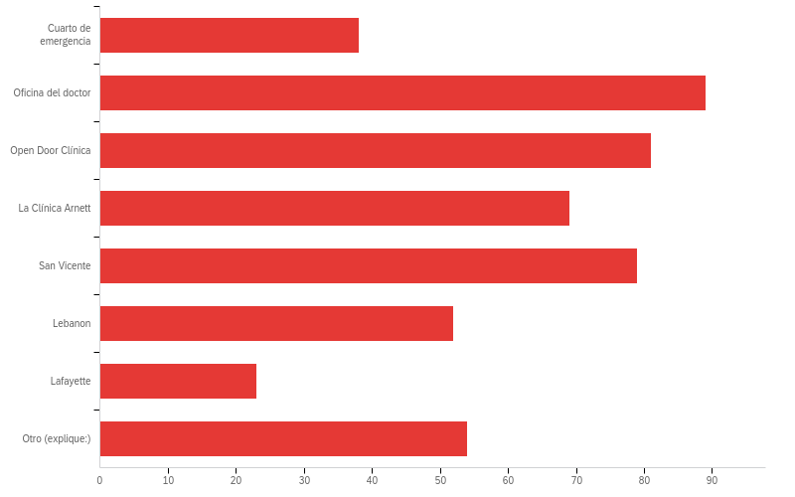
¿Dónde consigue atención médica?
8%
18%
17%
14%
16%
11%
5%
11%
Notes:
The most respondents seek medical attention from their primary care doctor’s office, which is great! The second most respondents seek medical attention from Open Door Clinic followed by St. Vincent Frankfort. More research is needed to discover reasons why respondents chose “other” and “emergency room” so frequently.

Slide 64
¿Por qué prefiere Ud. su médico principal?
37%
12%
14%
15%
14%
8%
Notes:
202 people (or 37%) of the respondents said that they look for convenience first, kindness (84 people or 15%) second, Spanish language ability (78 people or 14.1%) third, location (77 people or 13.9%) fourth, and low price (12%) last. 45 people (or 8%) mentioned other reasons for choosing a medical provider.

Slide 65
¿Hay alguna persona a la que Ud. considere su médico principal o proveedor de atención medica personal?
44%
4%
52%
Notes:
Having a primary care provider that can be the main point of contact for all your medical needs is very important. 215 people (or 52%) of the respondents said they do not have a specific person they go to when they need to seek medical attention.

Slide 66
¿Usted o a su familia tiene dificultades para conseguir cuidado médico?
Notes:
The biggest problems respondents had in finding medical care was 1) the cost followed by 2) the language barrier.

Slide 67
¿Por costo alto de la cita médica?

Slide 68
¿Por problemas para comunicarse por el idioma?

Slide 69
¿Por dificultad encontrar un doctor?

Slide 70
¿Por falta de transportación?

Slide 71
¿Por una fila o una espera demasiada larga?

Slide 72
MEDICAL INSURANCE

Slide 73
¿Tiene Ud. algun tipo de seguro médico?
47%
53%
Notes:
While the numbers of insured Latino residents has improved since 2010, still more than half of respondents (53%) are without healthcare insurance coverage.

Slide 74
¿Qué tipo de seguro médico tiene Ud.?
73%
4%
20%
3%
Notes:
Of those respondents who do have medical insurance, 164 people (or 73% of them) are insured through their employer, 46 people (or 20% of them) are insured through a government plan (like Medicaid), 8 people (or 4% of them) pay for their own insurance, and 7 people (3% of them) have cited other ways of obtaining healthcare insurance.

Slide 75
¿Sus hijos tienen algun tipo de seguro médico?
64%
17%
19%
Notes:
Of those who have children, 279 (or 64% of them) are covered by healthcare insurance of some type, which is great news! However, 75 people (or 17% of respondents) have children who are not covered by healthcare insurance.

Slide 76
¿Qué tipo de seguro médico tiene(n) su niño(s)?
37%
1%
50%
12%
Notes:
Of those respondents whose children do have medical insurance, 153 people (or 50% of them) are insured through a government plan (like Medicaid), 114 people (or 37% of them) are insured through a family member’s employer, 37 people (or 12% of them) have cited other ways of obtaining healthcare insurance, while only 5 people (1% of respondents) pay for their own insurance.

Slide 77
Healthy Communities of Clinton County
Healthy Communities of Clinton County, which will soon be located at 1234 Rossville Avenue in Frankfort, has a bilingual navigator, Maddy Balero, on staff to help people sign up for healthcare insurance. She is able to assist with Medicaid and Marketplace insurance for all income levels.
She can assist those who are undocumented by signing them up for emergency Medicaid when they have a qualifying life event, such as a pregnancy or emergency hospital visit.
Legal permanent residents for less than five (5) years, who have not been offered healthcare by their employer, are eligible for emergency Medicaid or Marketplace. LPRs for more than five (5) years and citizens may also qualify for Medicaid, as long as they meet the requirements.

